Slide 1
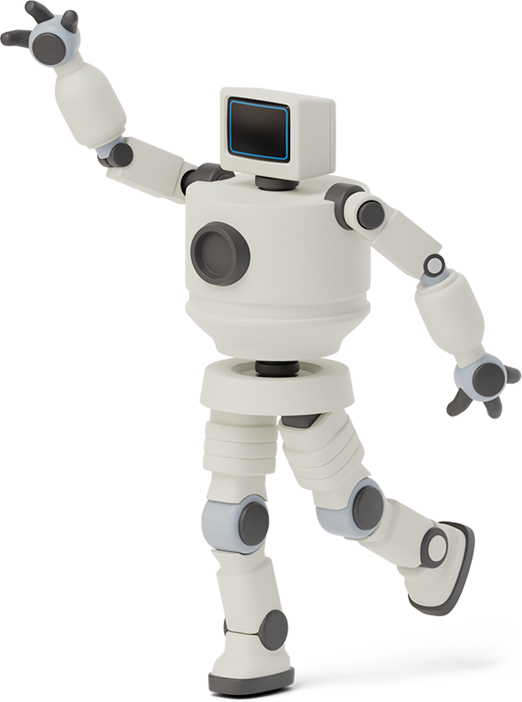


EE/ME 106A:
Foosball Bot
Pranit Mohnot, Sam Phillips, Susanna Weber

Slide 2
Original Goals
Detect the ball and goalie positions
Predict the path of the incoming shot
Sensing
Planning
Actuation
Reliability
Use the vision input to control the goalie
Block at least 75% of incoming shots
Notes:
Scout

Slide 3
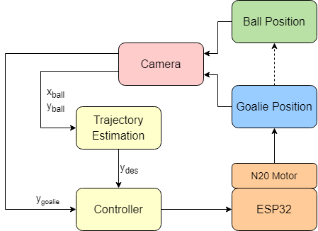
System Diagram
Notes:
Pranit

Slide 4
Sensing + Communication
Use open-cv python library to detect color
Code records coordinates of goalie and ball
Send visual information to ESP32 using pyserial library
ESP32 actuates based on distance between desired and actual goalie location
Notes:
Scout

Slide 5
Planning (Trajectory Estimation)
Run an LLSE regression on last 10 ball (x,y) locations
From regression: set y_{des} to where ball trajectory crosses goalie.
Run another regression on last 10 ball (x,time) pairs.
If ball is not moving towards the goal, reset y_{des}to y_{ball}.
If y_{des} outside of safe limits, saturate to y_{des, min} or y_{des, max}.

Slide 6
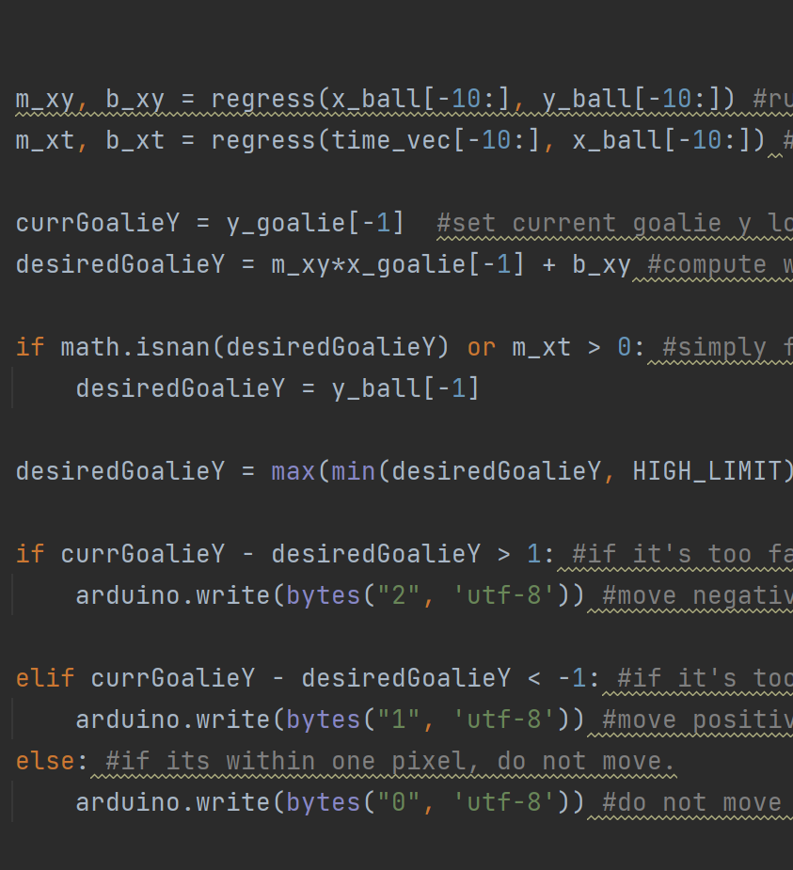
Planning (Control)
Option 1: PID Control
Onboard ESP32 (not laptop)
Caused timing issues with serial communication
Limited actuation range (PWM from 200 to 255)
Requires tuning
Limited steady-state oscillations
Option 2: Signed Bang-Bang Control
Laptop sends direction (0,1, or 2) to ESP32
Simplified code
Actuate at PWM magnitude of 250
No tuning
Has steady state oscillations

Slide 7
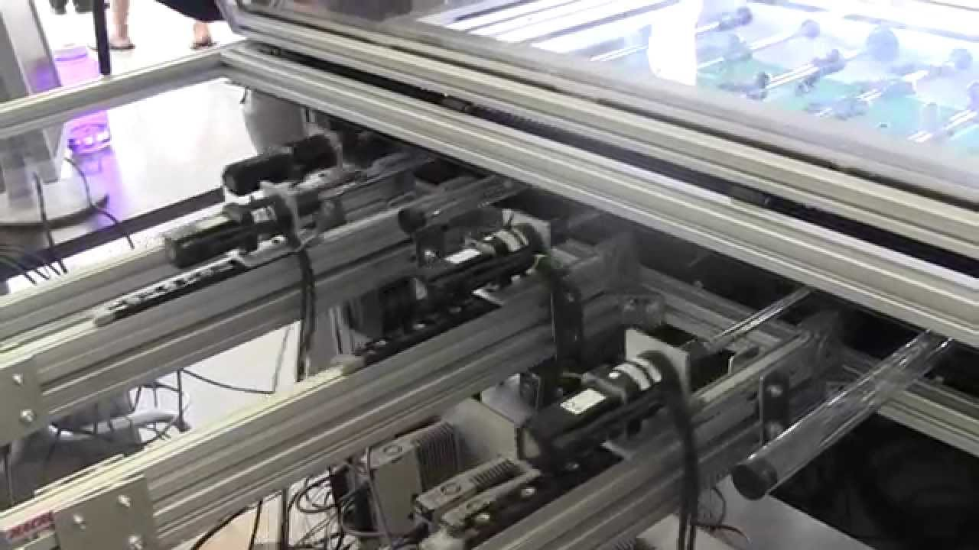
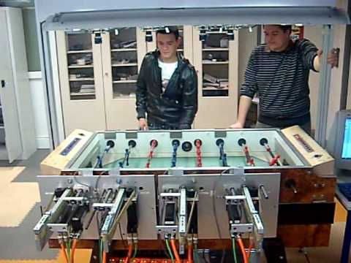
Actuation
Existing solutions:
Too big + expensive
Not self contained
High level goals:
Actuate quickly enough to block ball
Have all components self contained to table
Cheap: Use components we own where possible, target <$25 build

Slide 8
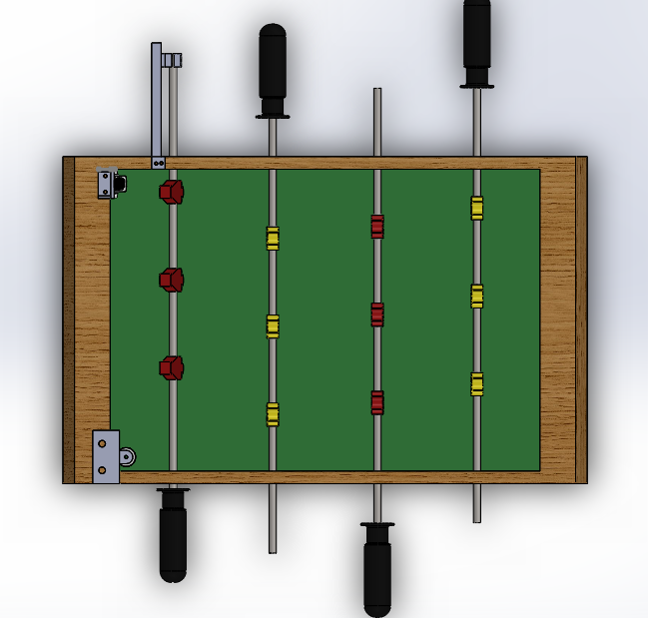
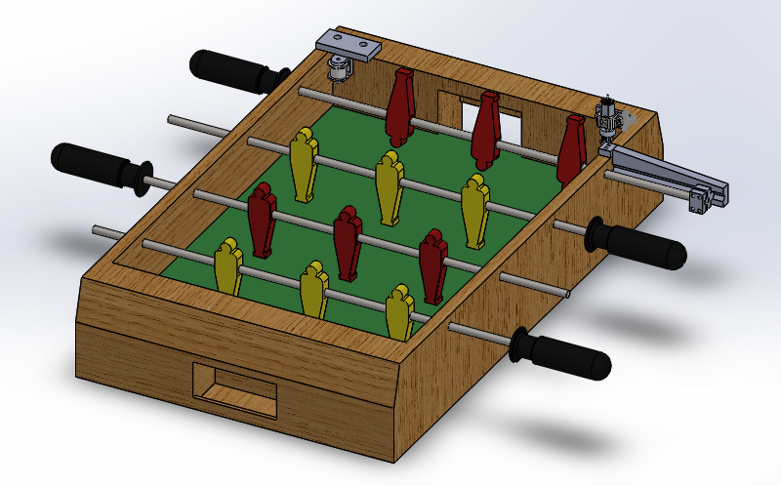
Actuation
High level design:
Use timing belt to move goalie
GT2 timing belts as cheap and widely available
3D printed mounts for motor and idler
Motor and idler contained within frame of foosball table

Slide 9
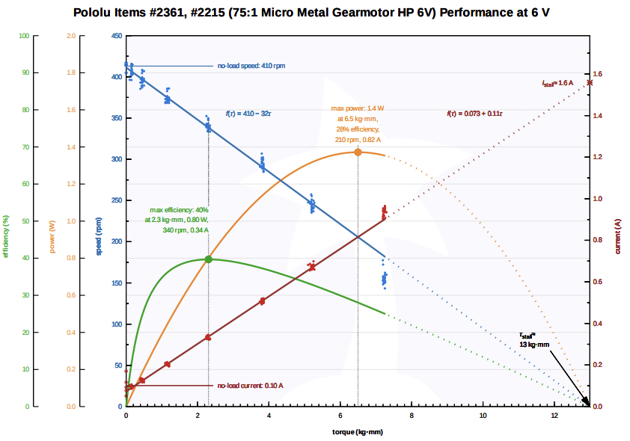
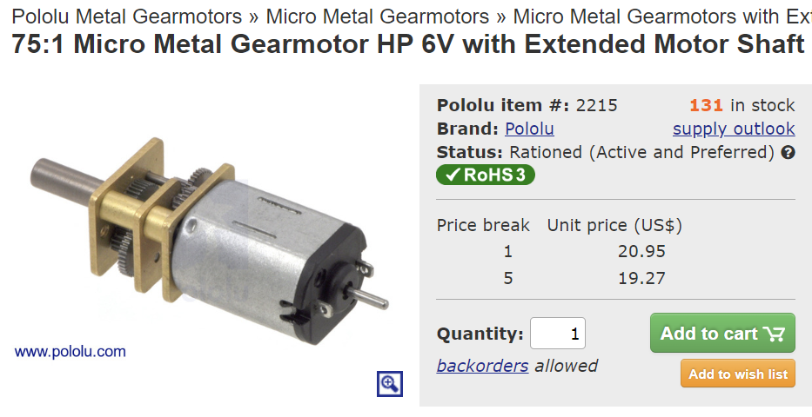
Actuation: Specification
Parameters:
Speed:
Measured how quickly goalie moves in regular game using a phone video
Max speed ~= 10 cm/s ~= 5 rps ~= 300 rpm
Load
Negligible force, load not of concern
Selection: 75:1 Micro gearmotor Pololu #2215
The best part is the one you already own ;)

Slide 10
Difficulties
Color detection
HSV ranges, different lighting, glossy vs matte paint
Code runtime
Time to perform regression is limited by ball’s speed
Motor limitations
Can only move player for PWM values >200 (max is 255) so do not have full range of control we would like to do smooth PWM control over wide range of speeds
Notes:
Scout

Slide 11
Possible Improvements
Goalie kicks the ball back
Adds another degree of freedom + could make goalie try to score on you
Goalie can detect when it blocks or detects successful goal
Adding a pressure sensor to the goalie and inside the goal
More robust CV
Use shape as well as HSV values, use canny edge detection
Would require faster computation
Notes:
Pranit

Slide 12
Thank you!
Demo time :)

Slide 13
Video
Gameplay
Top down view

